Slide 1
Origins: Evolution, Genetics & Development
Randall C. O’Reilly

Slide 2
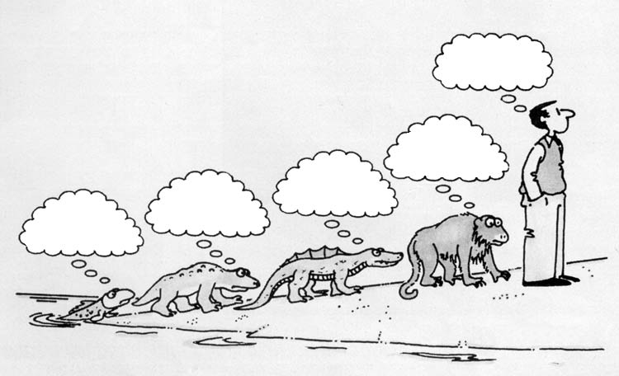
Evolution?
How does a fish EVER give birth to something other than a fish!?

Slide 3
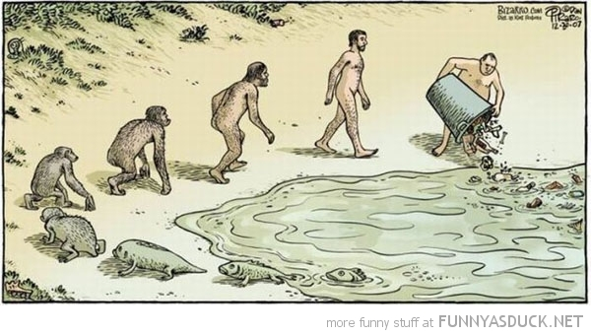
☺

Slide 4
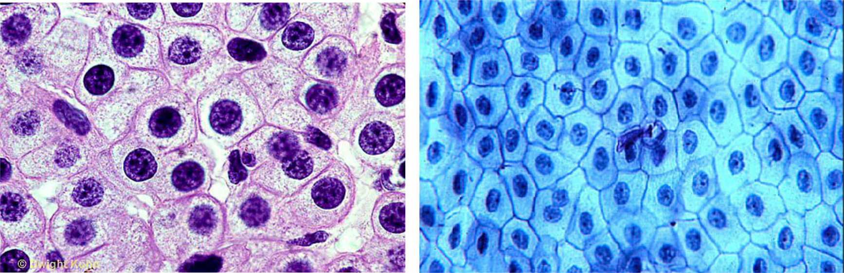
Hard to Fathom
It took a long time (longer than you can imagine!)
- very, very gradual change..
We don’t think of ourselves as cells (which is frog, human?):
Notes:
?

Slide 5
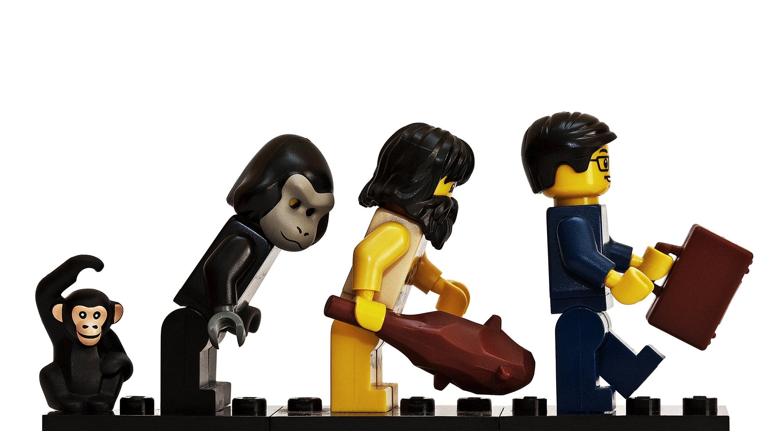
Evolution and Lego

Slide 6
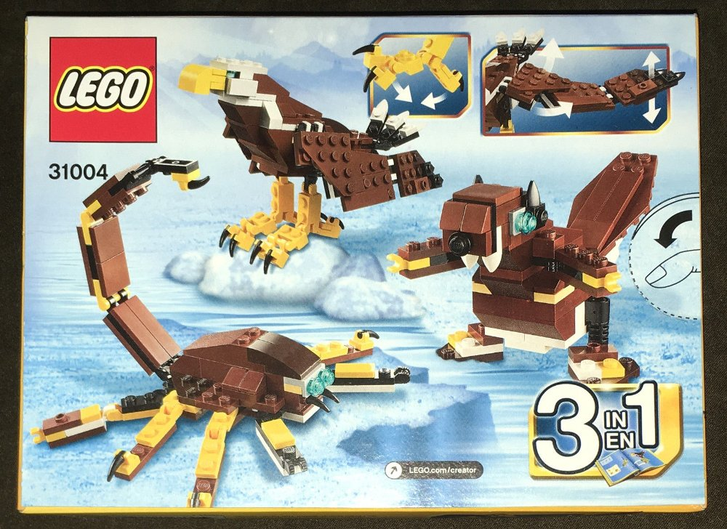
The same parts, reconfigured..
Evolution operates on an elaborate “instruction booklet” for constructing bodies from basic building blocks – the instruction book is subject to random and powerful hacking..

Slide 7
Fast Forward..
Soft robots evolving in front of your eyes:
https://www.youtube.com/watch?v=z9ptOeByLA4

Slide 8
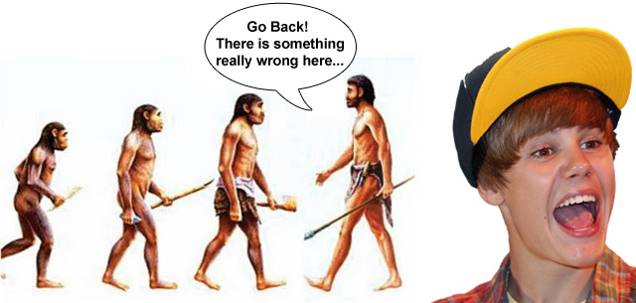
It is not an optimization process! (just everyone trying to get by..)

Slide 9
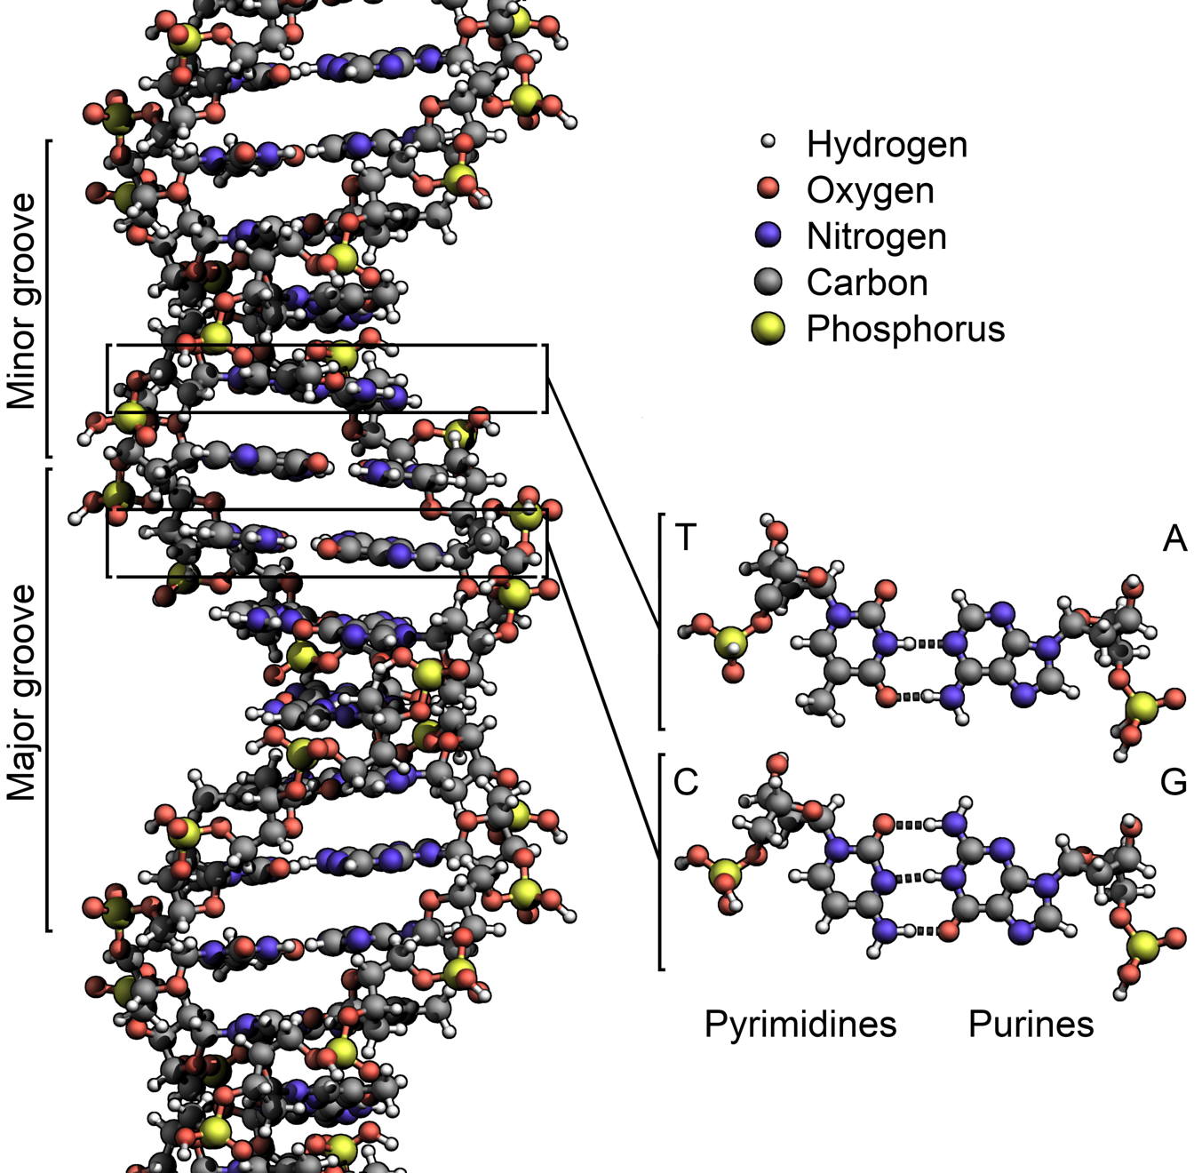
The Instructions
Genes = Lego instruction pages
Base pair (G,C,T,A: Gattaca, nucleotide) 3 = one Lego brick (amino acid)
Gene = Protein = sequence of amino acids (~300 = ~900 bp’s, but genes ~27,000 bp)
Alleles = different instructions for different folks – different gene variants

Slide 10
The Instructions
Genes = Lego instruction pages
Only 1.5% of human DNA codes for proteins, ~20,000 proteins in all (like most animals)
Between 20-85% of DNA may be “junk”
Rest is regulatory & control: if, then, else, for, while, etc of the genetic program!

Slide 11
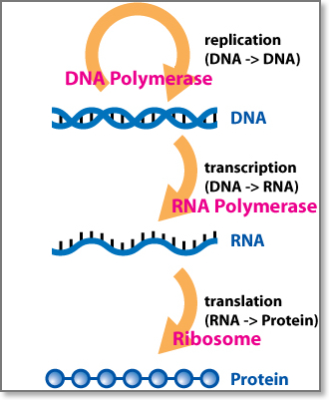
RNA and DNA
DNA makes RNA (Transcription)
RNA makes proteins
(Translation)
Proteins make us

Slide 12
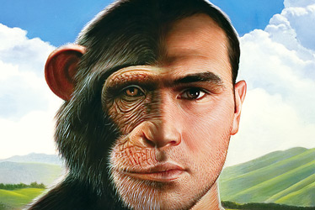
98.8% Human?
Proteins largely the same, but regulatory / junk areas differ by ~5%

Slide 13
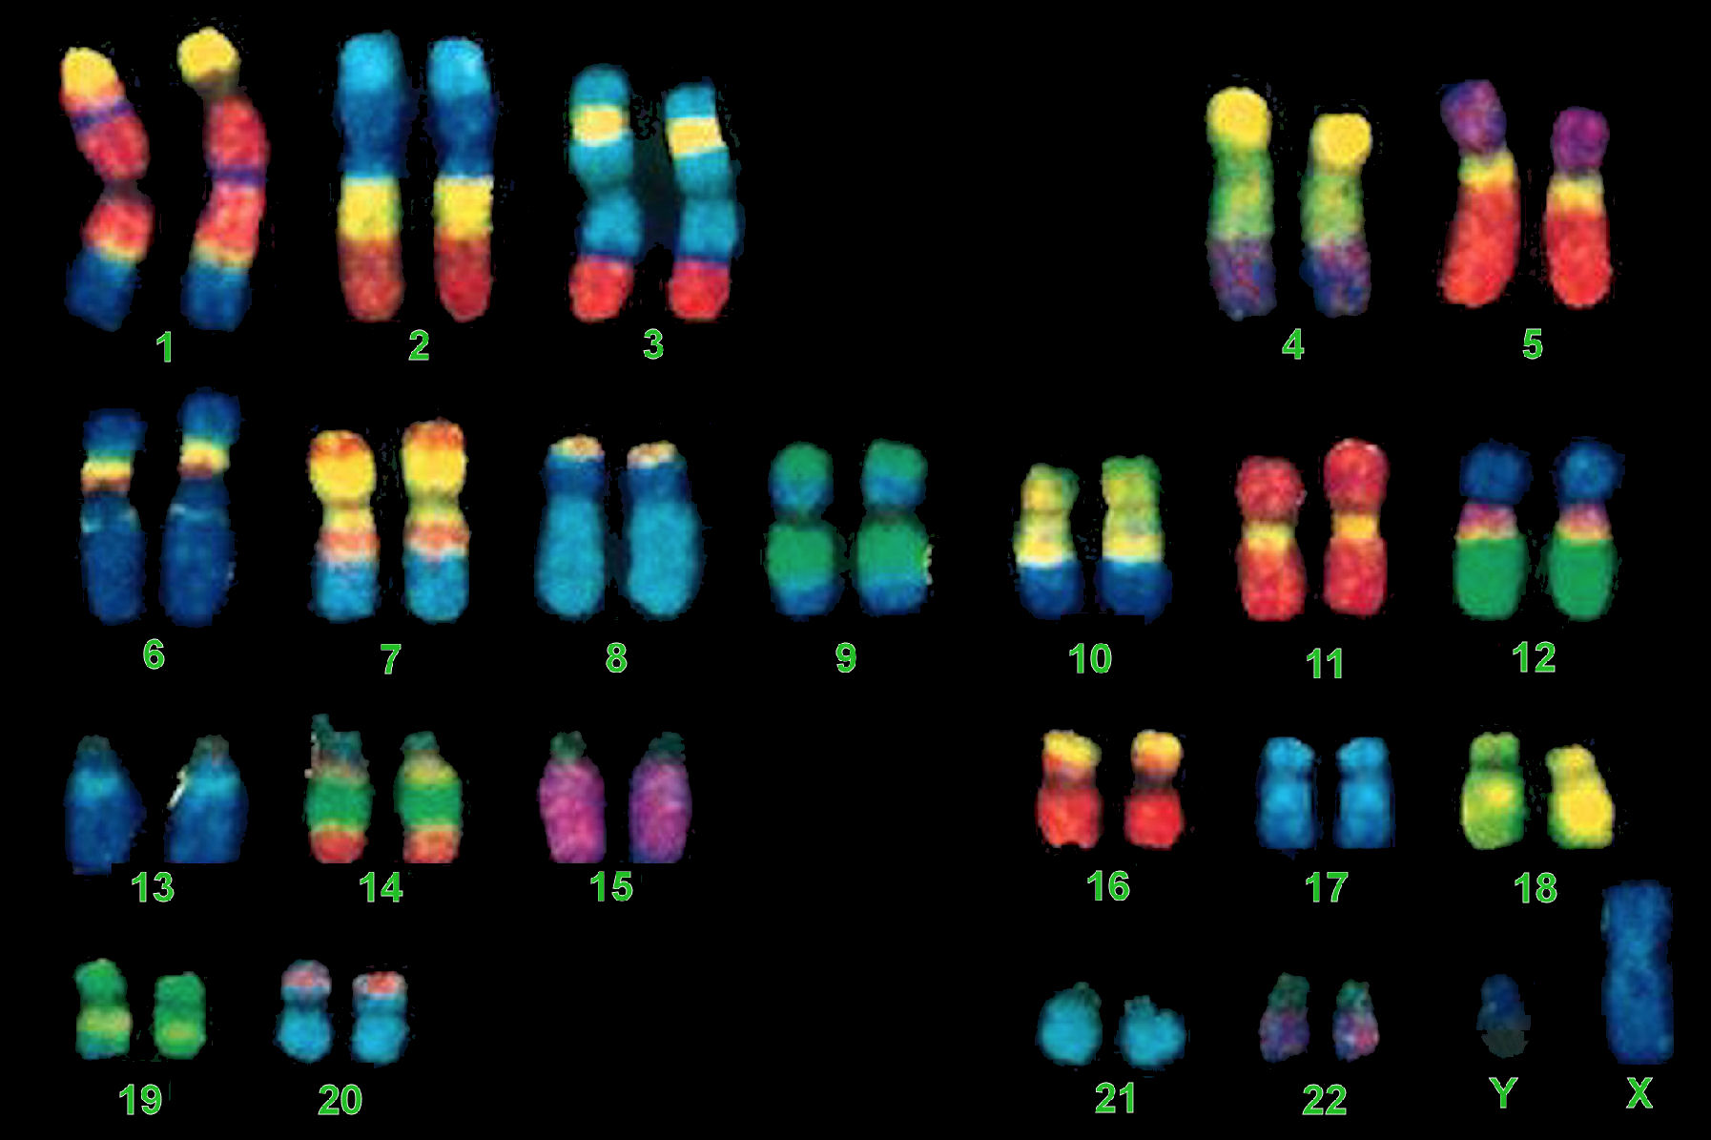
Chromosomes etc
2x of everything: mom + dad = 2
Dominant vs. recessive:
DD, Dr, rD, rr =
¾ dominant, ¼ rec.
All the bad stuff is recessive: why incest is risky!
Notes:
Chromosomes: in the nucleus of a cell, made up of DNA
Dominant gene controls phenotype, recessive gene does not

Slide 14
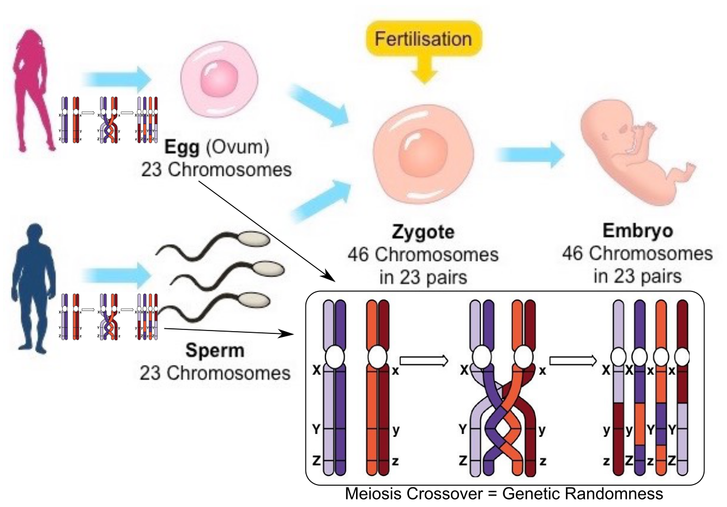
Sex = Genetic Randomness (but mixing is on grandparent’s genes!)

Slide 15
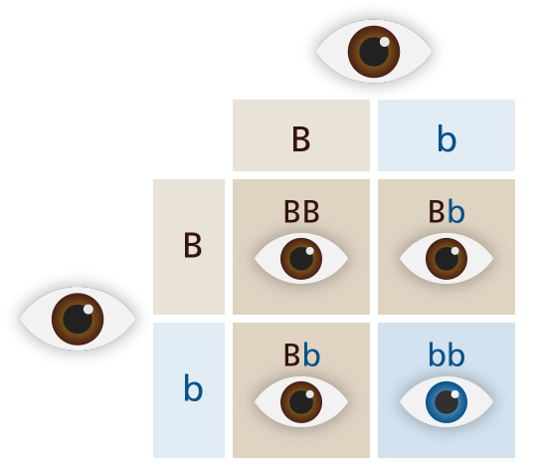
Dominant vs Recessive Logic

Slide 16
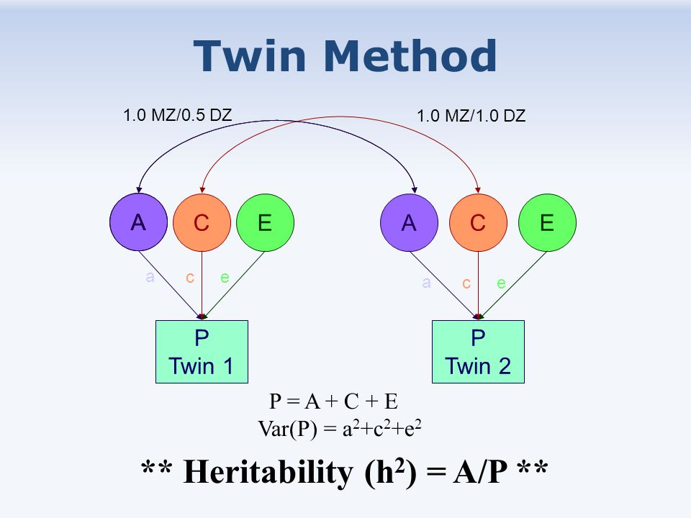
Heritability estimated from Twins
A = Additive genetic factor; C = Common (shared) environment; E = Unique environment

Slide 17
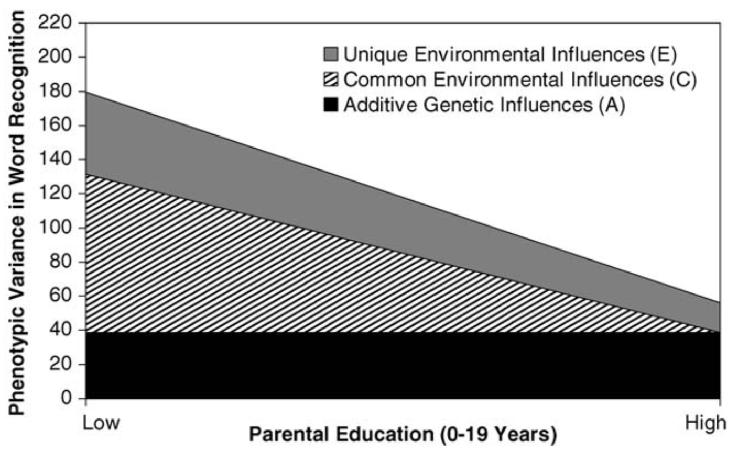
Heritability is tug-of-war between genetic and environmental factors
If environmental influences go down, measured amount of genetic heritability goes up even if the actual genetic influence remains exactly the same!!!

Slide 18
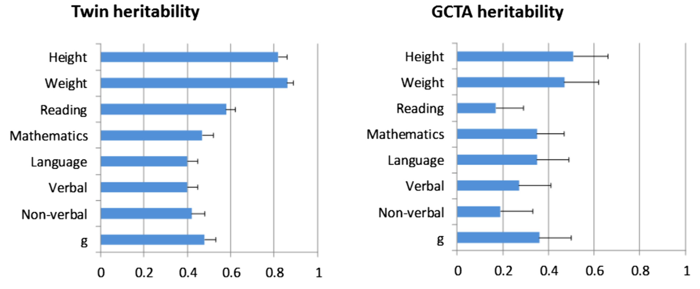
Heritability
h² = proportion of variance explained by genetics
Twin studies = 2x direct genetic contributions – missing heritability problem, or excess heritability in twins!
Notes:
Why do you think variables like personality and social attitudes seem to be less heritable than these different disorders?

Slide 19
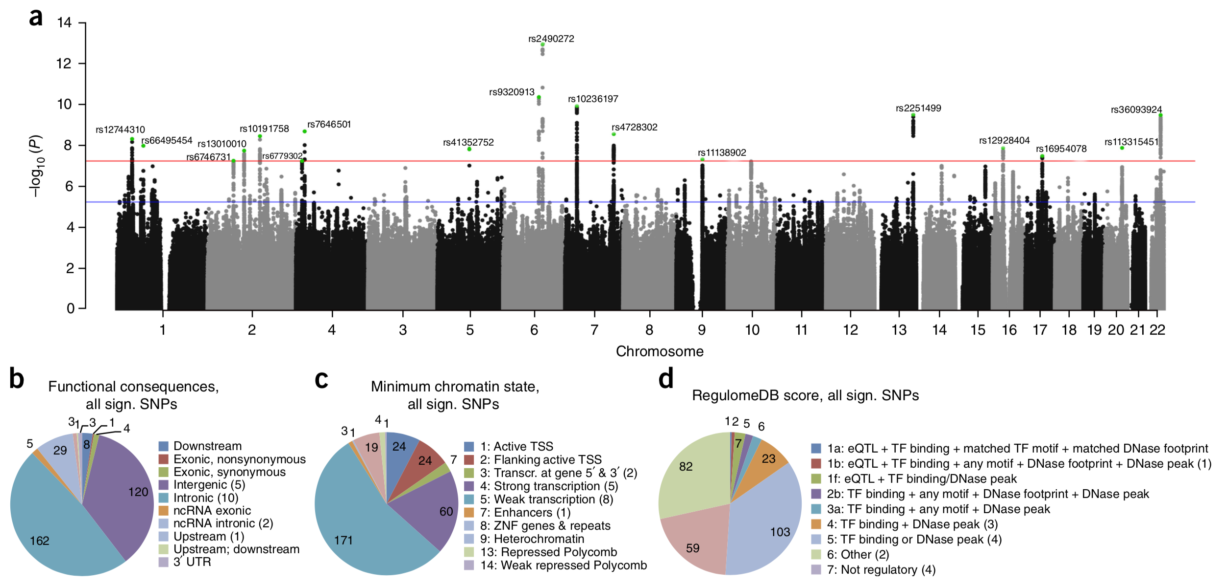
Genes and IQ
Genome-Wide Association Study (GWAS) for IQ: No single gene explains much, but if you put them all together, ~20% heritability.
IQ = Phenotype: observable characteristics or traits

Slide 20
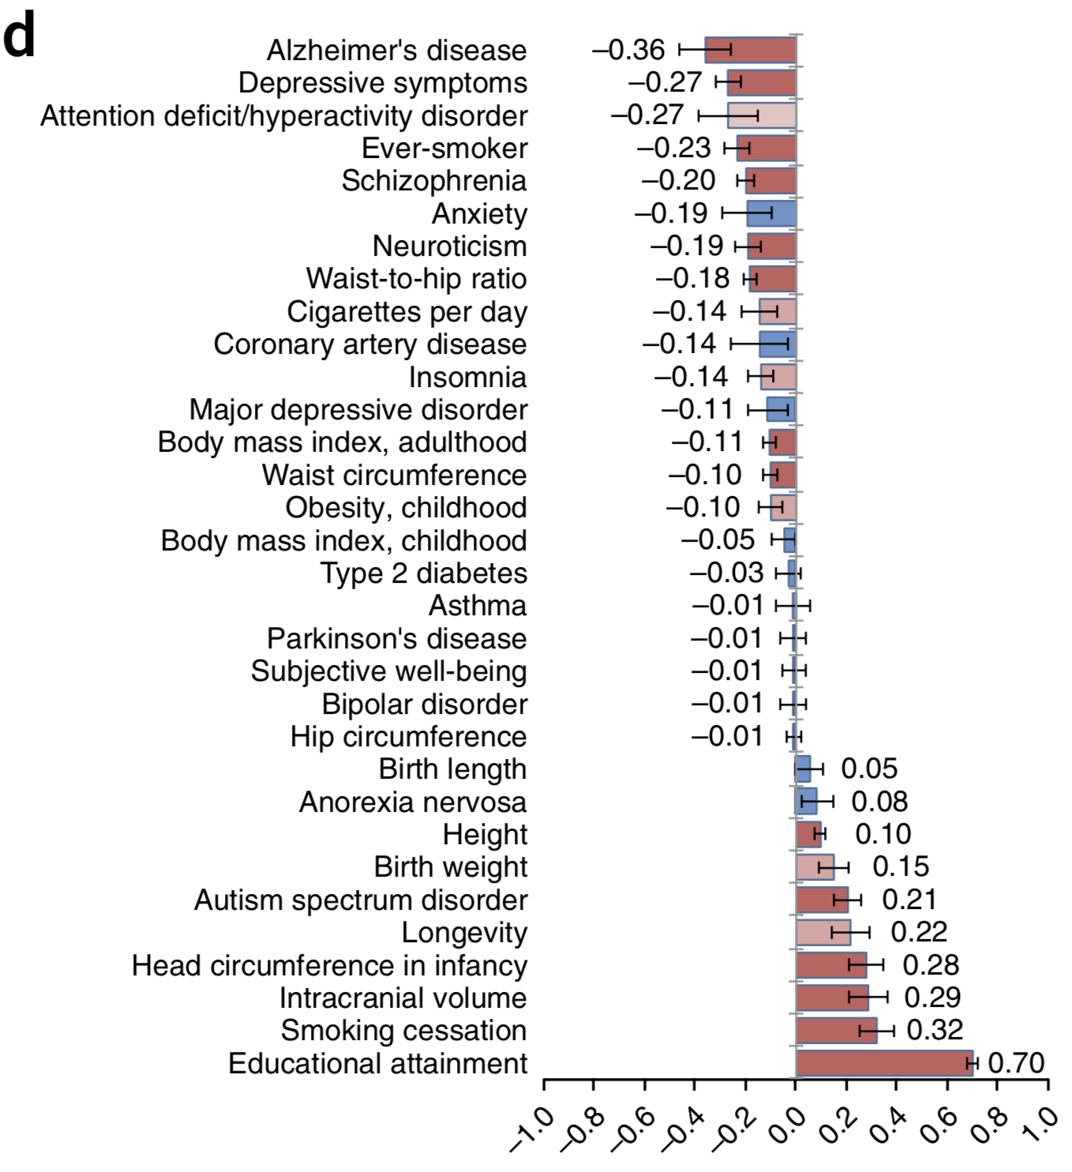
IQ Gene Associations

Slide 21
Gene / Environment Correlations
Overestimate heritability because genes influence environments!
Geeks seeking geeks do geeky things together which makes them even geekier, and thus more likely to rule the world!
And, yes, non-geeks shunning said geeks, further reinforcing said geekiness (reactive vs. active).

Slide 22
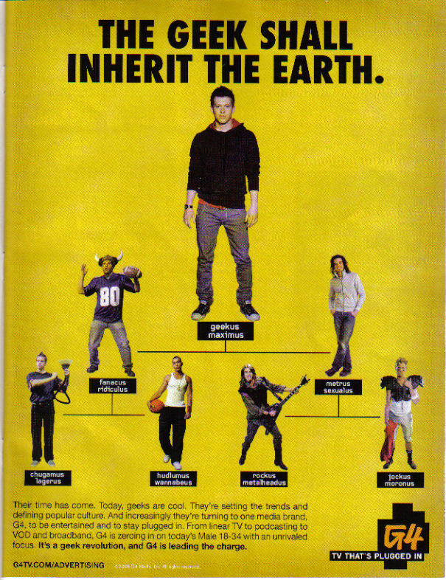


Slide 23
Everything is a Nature/Nurture Interaction
Can’t be smart if you can’t eat.
Deprivation of the basics leads to developmental problems no matter what genes you have
Parents give you genes and, for most, your early environment (c.f., twins reared apart!)
Brain is highly plastic (adaptive): h² of IQ gets larger over time: it’s about learning!

Slide 24
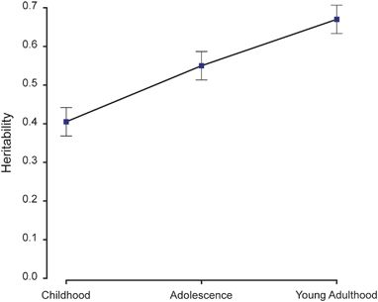
IQ Heritability goes UP over time!
Also: Flynn effect: IQ is going up over decades

Slide 25
Nature Nurture Summary
Genes: made from DNA, determine how body develops (the program)
Genotype = all genes; Alleles = different versions of gene
Phenotype: measurable traits (IQ, ADHD..)
Behavior(al) genetics: study of genetic vs. environment influence on behavior, etc
Identical vs. fraternal twins vs. unrelated siblings
Heritability (h²): amount of variance between people that is due to genes (0..1) (low variance = more h²)
Almost everything has some heritability.. often ~.5

Slide 26
Nature Nurture Summary
Environment: (shared = family, vs. unique) – everything outside of genes that affects you..
Everything (genes, environment) typically has an effect on everything.. e.g., IQ = 50/50
Gene / Environment Correlation: environment affected by genes.. (geeks!)
Gene / Environment Interaction: different people respond differently to same environment

Slide 27
Development
How do we go from jello to genius?
Babies are complete idiots (Onion headline)
Every one of you is capable of amazing feats of cognition that cannot be captured in current AI – and it all develops automagically – how!?
What forces shape our development?
Social, parental, genetic, etc

Slide 28
Development is Amazing
We are (fascinated by) butterflies: baby you is as different from adult you as a caterpillar and a butterfly!
https://www.youtube.com/watch?v=InPRQNQBj5c
https://www.youtube.com/watch?v=ZTjHLF3xKWo

Slide 29
Babies are Idiots
https://www.youtube.com/watch?v=lhHkJ3InQOE
(my son Kai)
https://www.youtube.com/watch?v=0L7xzcvJzZc
(my son Max)
Development = big, obvious effects – good window into components of cognition

Slide 30
What Develops, When?
Just think about everything you know:
Sensory-motor skills: recognizing, naming objects, reaching, manipulating, walking, talking, running…
Many animals born with these skills, why do we take so long?
You can’t even control your bowels for 3 full years!?
CCC = Controlling your behavior: first there are no tantrums, then there are, then they get less frequent.
Socialization: mine mine mine! -> share, play together…
And then you go to school, college…

Slide 31
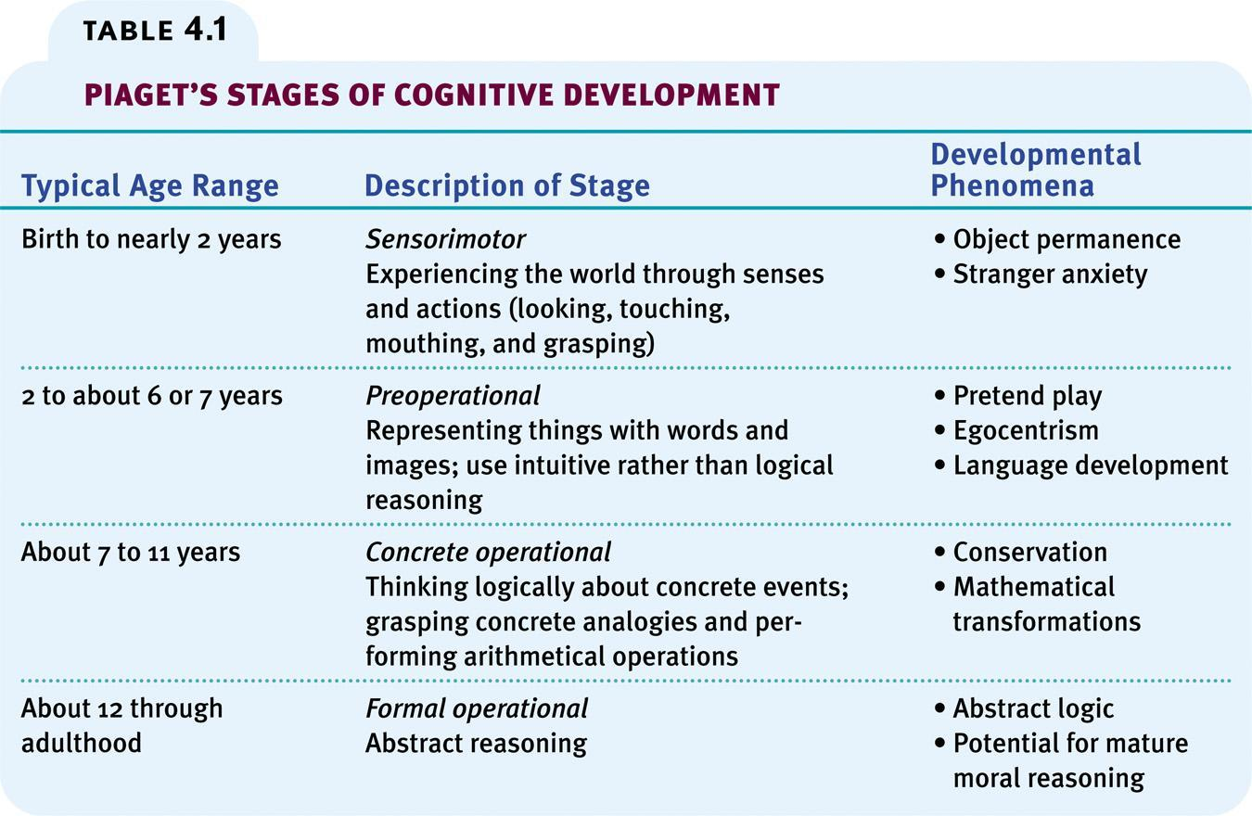
No actual stages.. But useful simplification

Slide 32
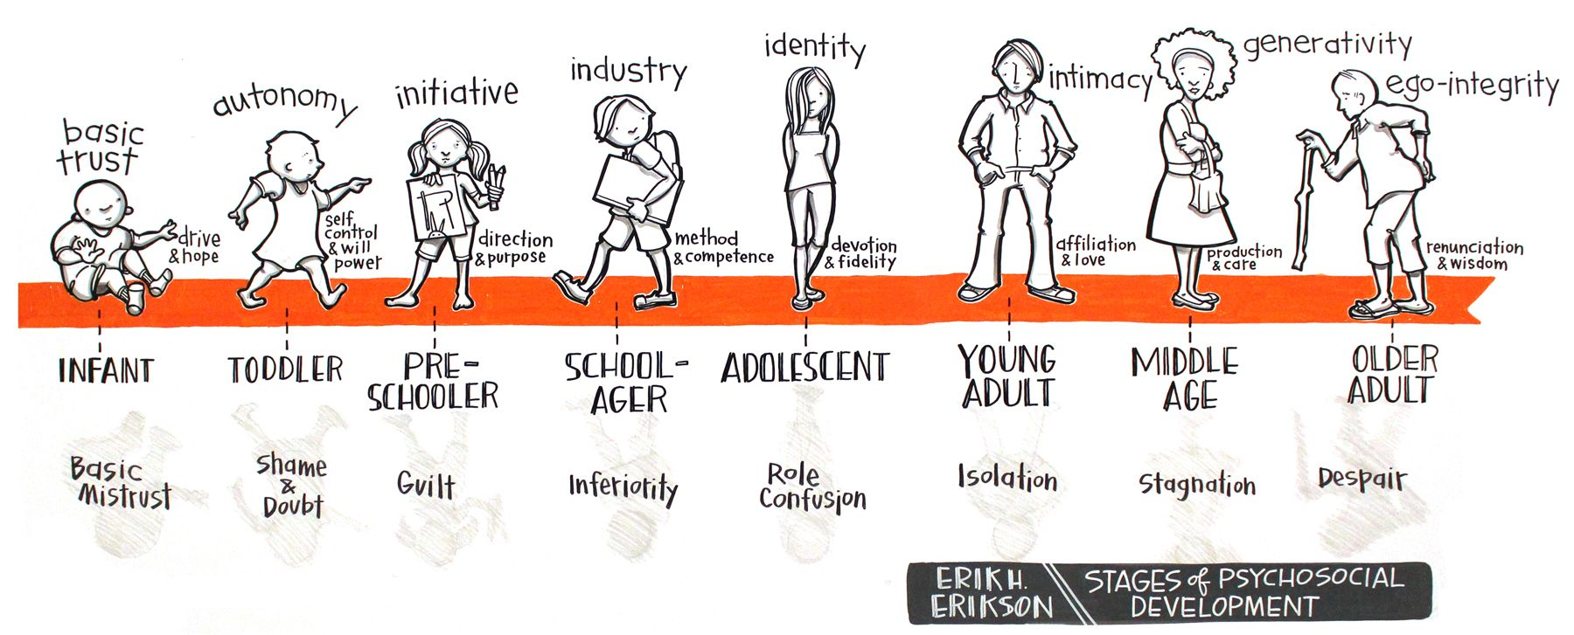
Erikson Psychosocial Development

Slide 33
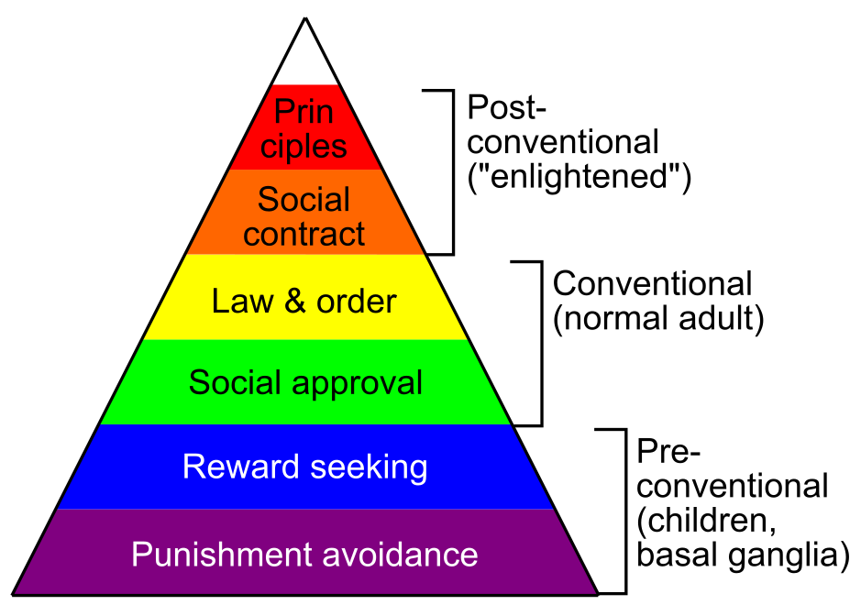
Kohlberg’s moral stages

Slide 34
Moral Development (basic drives to make society work)
Haidt:
Care / harm: like reward / punishment – basic
Fairness / justice: no cheaters! Or cheated!
Group Loyalty: love the in-group, hate the out-group
Respect for authority: stay in line!
Purity and sanctity: rules about sex, food, nudity, etc

Slide 35
How Does it Work?
Problem: Truly understanding development requires truly understanding how it all works! (absurd to teach 1 lecture on this topic!)
Brain maturation?
Learning?
Schema assimilation, accommodation? (Piaget)
Internal drives?
External forces (social, parental), schooling?

Slide 36
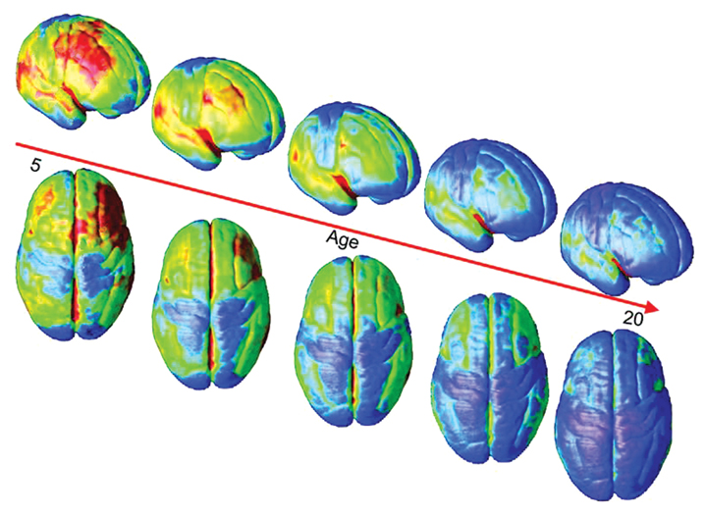
Brain Maturation: Synaptic Pruning
Blue = thinner = more synapses pruned = more mature
Sensory areas mature first, then “higher level” areas; PFC last of all

Slide 37
Early Sensory/Motor Learning
First 6 months: learning to predict what you’ll see next – passive sensory learning about basic physics, object permanence, object shapes, etc
CCC = Compression, Contrast
We have initial computer models of this
E.g.: Objects are solid, Objects only move through contact, Objects travel through space in continuous path.. Spelke et al: Nativism (built-in) vs. learned..
Physics = a “schema”?

Slide 38
Early Sensory/Motor Learning
Then: more active motor grasping and manipulation – starting to learn about self-efficacy
Learning that we can affect the world, prelude to full sense of agency..

Slide 39
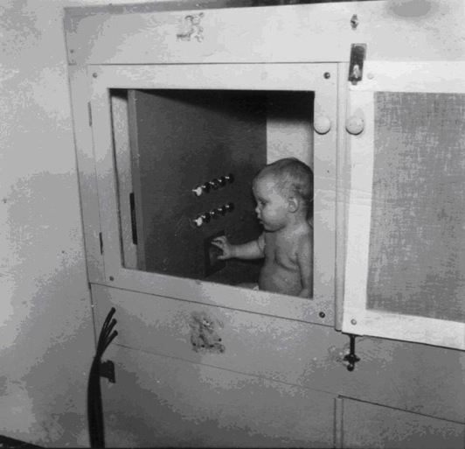
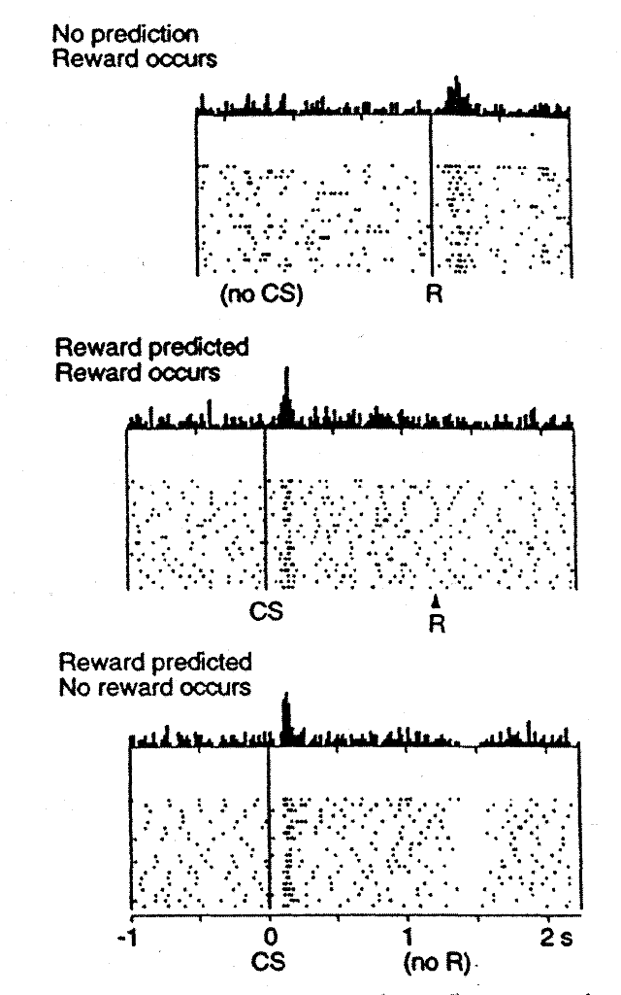
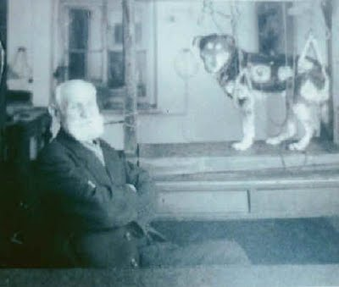
How Much of Learning is Passive?
Pavlov
Skinner
Dopamine

Slide 40
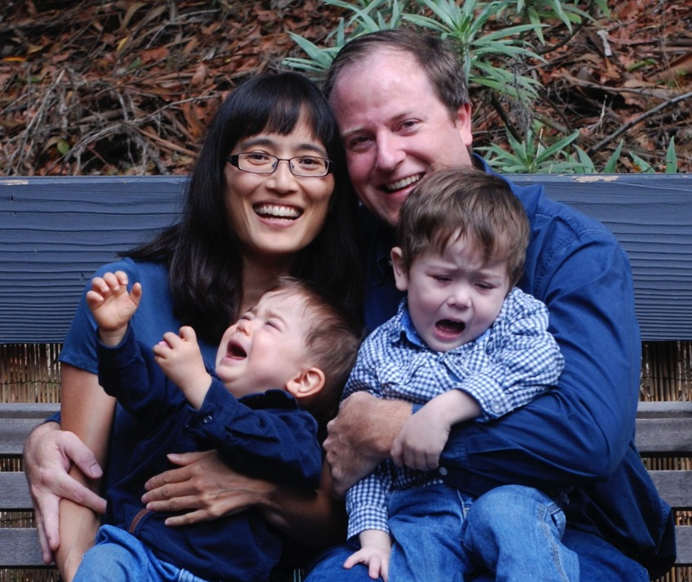
At 2 Years of Age, a Miracle Occurs
Tantrums!!!

Slide 41
Human Learning is Active! CCC = Control!
Kids carefully decide what to try or avoid
Boredom and curiosity drive expansion of abilities over time
Social influences are major: kids especially sensitive to peers – we are herd animals!

Slide 42

The Nurture Assumption
Very little evidence of parental influence on children, beyond genetics
Genetic / environment correlation?
Peers matter the most of environmental influences
Which language to immigrants learn?
Who did you talk most w/ in High School?
What data tells us these things?

Slide 43
Extreme Cases
Parents only don’t matter if they’re ‘normal’ (and actually present)
Romanian orphans
Abuse, neglect, etc
(Same point about genetics dominating when there isn’t too much variance in the environment: how different really are different parents?)

Slide 44
Temperament: Personality vs Big 5 OCEAN
Effortful control: Conscientiousness
Negative emotionality: Neuroticism / not-Agreeableness
“avoid” dimension
Extraversion: Extraversion / Openness
“approach” dimension
Basic “parameters” on motivational system..

Slide 45
Attachment Theory
Nice metaphor, but likely largely bogus..
We don’t see entire world through lens of mother (how many others fit the mother role??)
Strange Situation and Attachment Styles:
Secure: Need mommy, miss mommy, all good with strangers as long as mommy is around..
Avoidant: Disengaged, even from mommy..
Insecure-Ambivalent: Wary, anxious, mad at mommy..

Slide 46
Beyond Boyhood
Adolescence: Everything in place except good judgment! And an appreciation of it all..
youth is wasted on the young
Young adult: what do I do with my life?
Adult: joys of parenting, marriage
Midlife: did someone say crisis?
Golden years: and then you die..

Slide 47
Development Summary
Brain maturation = synaptic pruning, goes from sensorimotor up to higher areas (prefrontal cortex is last = Control area)
Overall Stages: Sensorimotor, preoperational, concrete operations, formal operations
Temperament: reasonably stable, effortful control, negative affect (avoid), extroversion (approach)
Attachment: secure, avoidant, insecure/ambivalent: reflects personality vs. shapes it? (Reflects!)
Adolescents: lack PFC for making good decisions..

Slide 48
Research Methods
It is especially challenging to figure out what preverbal, jello-ball babies are thinking!
- they can’t talk, point, push buttons..
How would you do it? Hint: have you seen The Theory of Everything?

Slide 49
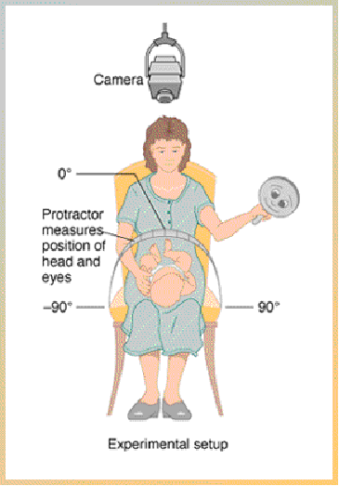
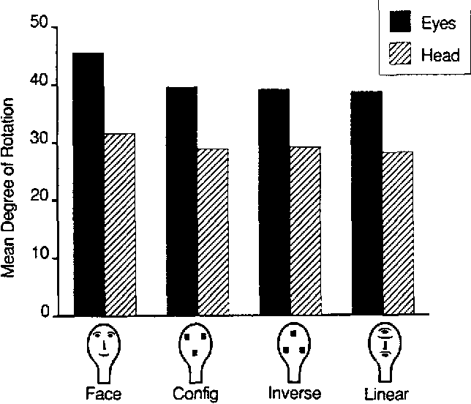
Visual Tracking

Slide 50
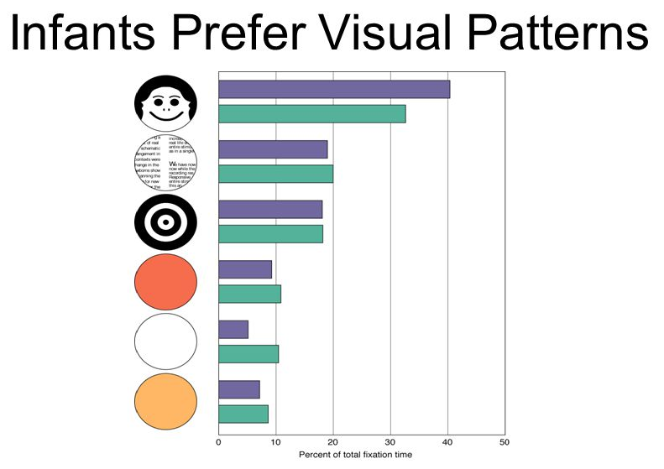

Slide 51
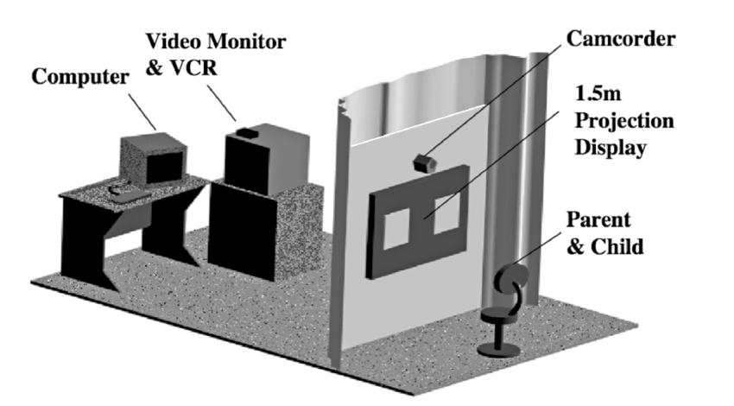
Preferential Looking: Habituation

Slide 52
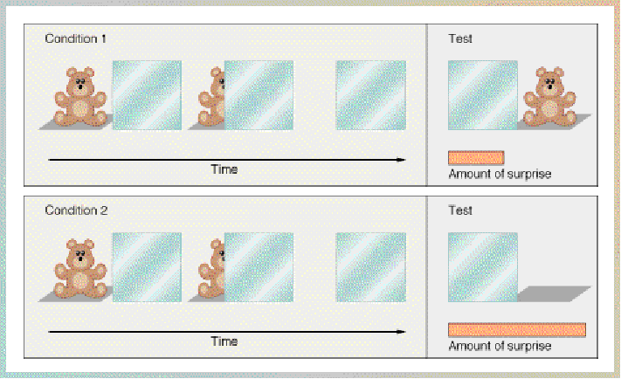
Object Permanence

